Slide 1
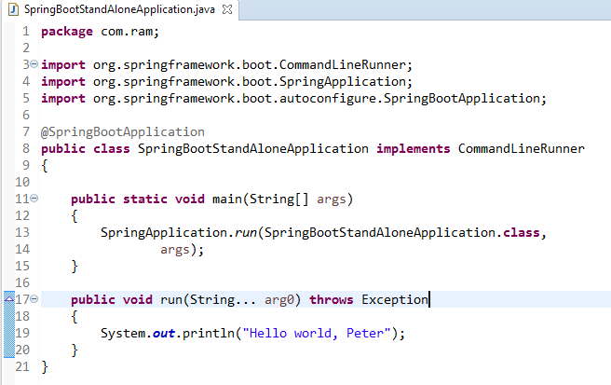
Spring Boot – CommandLineRunner interface example
CommandLineRunner is an interface. It is used to execute the code after the Spring Boot application started.

